Slide 1


Distributed Messaging with Apache Kafka
Mateusz Dymiński

Slide 2
whoami
Mateusz Dymiński
Software Developer(Architect) at Nokia
>10 years in industry
>6 years Java dev
>7 years Go dev
Still writing code : )
Tech confs speaker
LinkedIn, GitHub, FB, Twitter - see https://mateuszdyminski.com/

Slide 3

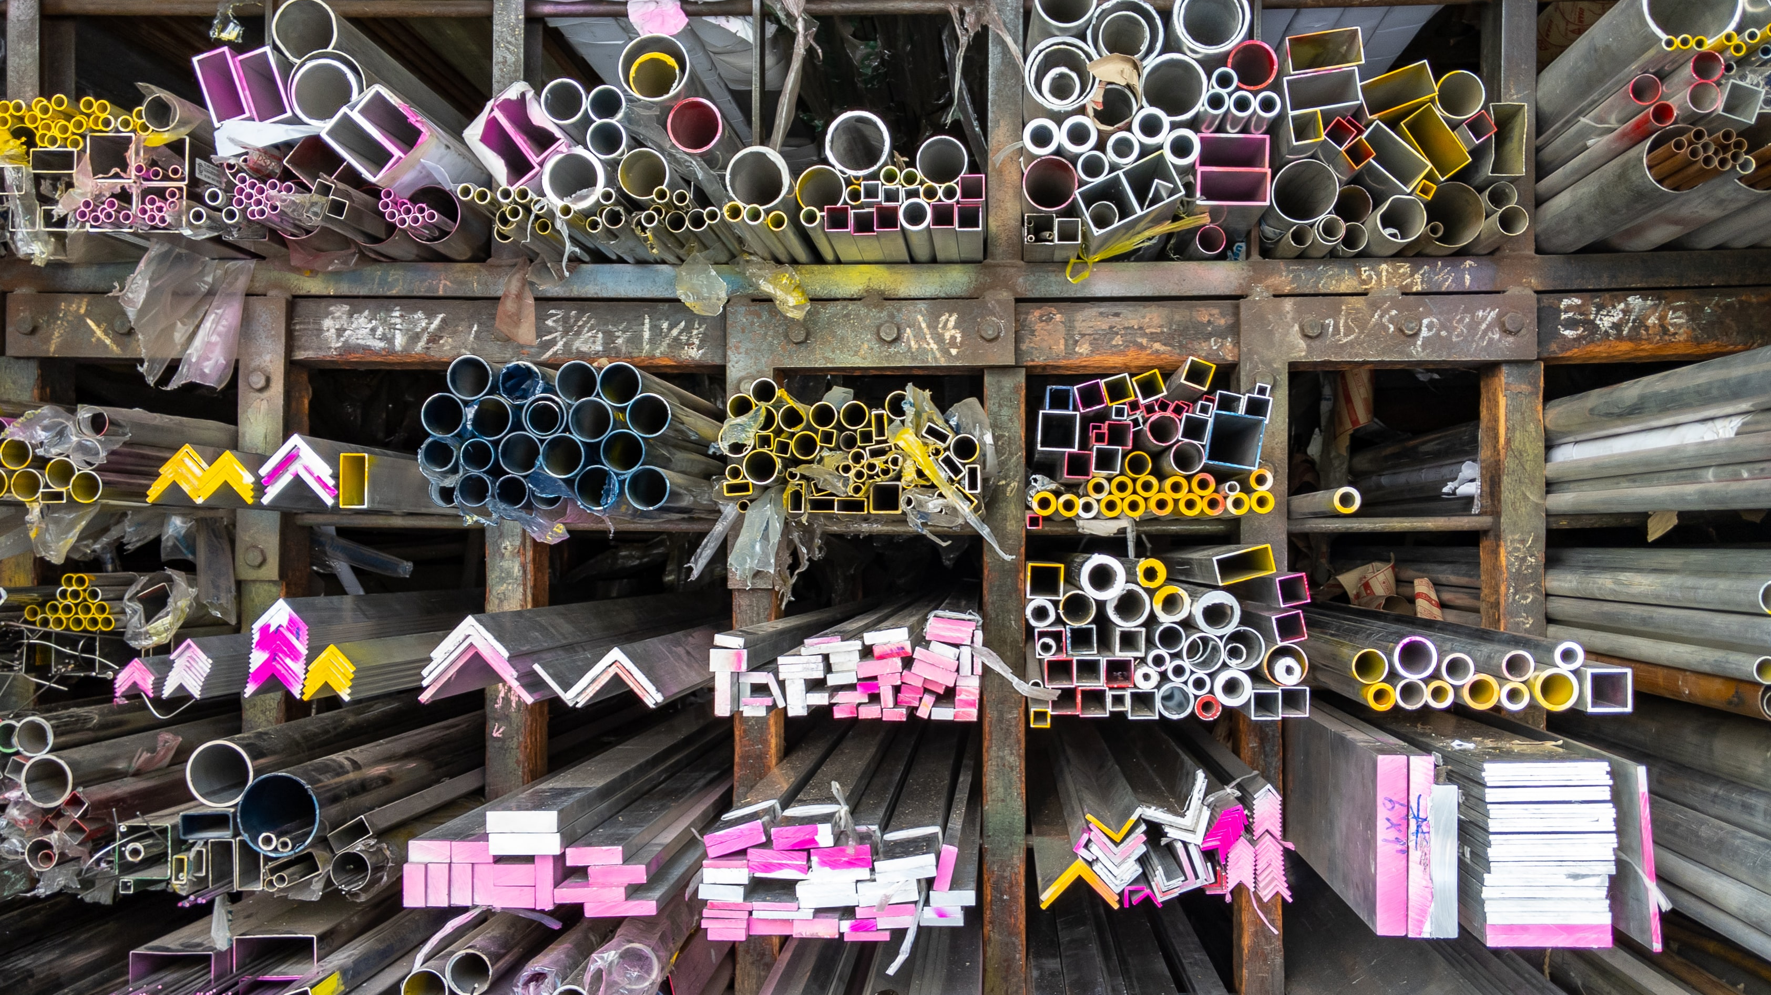
Materials: presentations, sources etc.
https://github.com/mateuszdyminski/dist-messaging-workshop

Slide 4

General rules of training

Slide 5
General rules
Training: 2 x 7h
Short breaks after sessions - 1h – 3-5mins
One long break for lunch – around 1pm ?
Ask questions anytime
Few exercises to keep you warm-up
No present list : )

Slide 6

Let's introduce ourselves

Slide 7
Exercise

Slide 8
Exercise
Think about problem which you would like to solve with Kafka
Write it down
Write down requirements/context
Functional requirements
Non-functional requirements
Constraints?
Time
Budget
Technology/Tools
Organisational/People
Send it to me - mail/zoom – dyminski@gmail.com

Slide 9
Exercise
During the workshop we’ll try to discuss your problems
And find solution ☺

Slide 10
Agenda
Overview of Distributed Messaging Systems
What's Apache Kafka
When it's worth to use Apache Kafka
Use Cases
Alternatives to Kafka
Design
Motivation
Persistence
Efficiency
The Producer
The Consumer
Message Delivery Semantics
Replication

Slide 11
Agenda
Kafka API
Producer API
Consumer API
Kafka Connect
Kafka Streams
Configuration
Producer
Broker
Consumer
Implementation details
API Design
Network Layer
Messages
Message format
Log
Distribution

Slide 12
Agenda
Basic Kafka Operations
Adding and removing topics
Modifying topics
Graceful shutdown
Balancing leadership
Checking consumer position
Mirroring data between clusters
Expanding your cluster
Decommissioning brokers
Increasing replication factor
Other
Datacenters
Important Server Configs
Important Client Configs
Production Server Configs
Monitoring
ZooKeeper

Slide 13
Agenda
Extras
Kafka + Kubernetes
Kubernetes Operator
Kubernetes Storage
Strimzi
CDC with Debezium
Serializers
Schema Registry
Security

Slide 14

Overview of Distributed Messaging Systems

Slide 15
Overview of Distributed Messaging Systems
What’s Apache Kafka
When it's worth to use Apache Kafka
Use cases
Alternatives to Apache Kafka
Summary of part 1

Slide 16
What is Kafka?
Kafka is a messaging system that is designed to be fast, scalable, and durable.
It is an open-source stream processing platform.
Originated at LinkedIn and later became an open-source Apache project in 2011
Kafka is written in Scala and Java.
It aims at providing a high-throughput, low-latency platform for handling real-time data feeds.

Slide 17
What is Kafka?
Apache describes Kafka as a distributed streaming platform that lets us:
Publish and subscribe to streams of records.
Store streams of records in a fault-tolerant way.
Process streams of records as they occur.

Slide 18

When it's worth to use Apache Kafka

Slide 19
Apache Kafka - pros
Comparing to other message systems – almost always Kafka is a better choice – but it depends on use case – we will cover that later on
When we care about scalability
When we care about consistency
When we care about fault-tolerance / disasters
When we care about speed
When we have many consumers with vary performance
When we care about ordering
When we care about Exactly Once

Slide 20
Apache Kafka - cons
To configure Kafka in fault-tolerant way – we need quite a lot of resources(cpu, mem, storage)
We need to have fast storage
We need to remember about Zookeeper – at least for a while
In most cases we need to deploy/operate Kafka by ourselves – but there are commercial platforms which offers Kafka in SaaS model

Slide 21

Use Cases

Slide 22
Use cases
Messaging / Asynchronous communication
Streaming
Real-Time processing
Metrics / Log aggregation
CQRS / Event Sourcing
Change Data Capture
Geo-replication

Slide 23
Messaging / Asynchronous communication
Services communicating by exchanging messages over messaging channels.
Very common in microservices world
Kafka main use case – send receive messages in publish-subscribe model
If we would like to send the message/event to other system/service we use producer
If we would like to be notify that message

Slide 24
Messaging / Asynchronous communication
There are several different styles of asynchronous communication:
Request/response - a service sends a request message to a recipient and expects to receive a reply message promptly
Notifications - a sender sends a message a recipient but does not expect a reply. Nor is one sent.
Request/asynchronous response - a service sends a request message to a recipient and expects to receive a reply message eventually
Publish/subscribe - a service publishes a message to zero or more recipients
Publish/asynchronous response - a service publishes a request to one or recipients, some of whom send back a reply

Slide 25
Asynchronous communication - benefits
Loose runtime coupling since it decouples the message sender from the consumer
Improved availability since the message broker buffers messages until the consumer is able to process them
Supports a variety of communication patterns including request/reply, notifications, request/async response, publish/subscribe, publish/async response etc

Slide 26
Asynchronous communication - cons
Additional complexity of message broker, which must be highly available
Request/reply-style communication is more complex
Harder to test – i.e. think about isolation in E2E tests

Slide 27
Messaging / Asynchronous communication - examples
Communication in microservices
Offload the consumers in your systems
CQRS
Many more

Slide 28
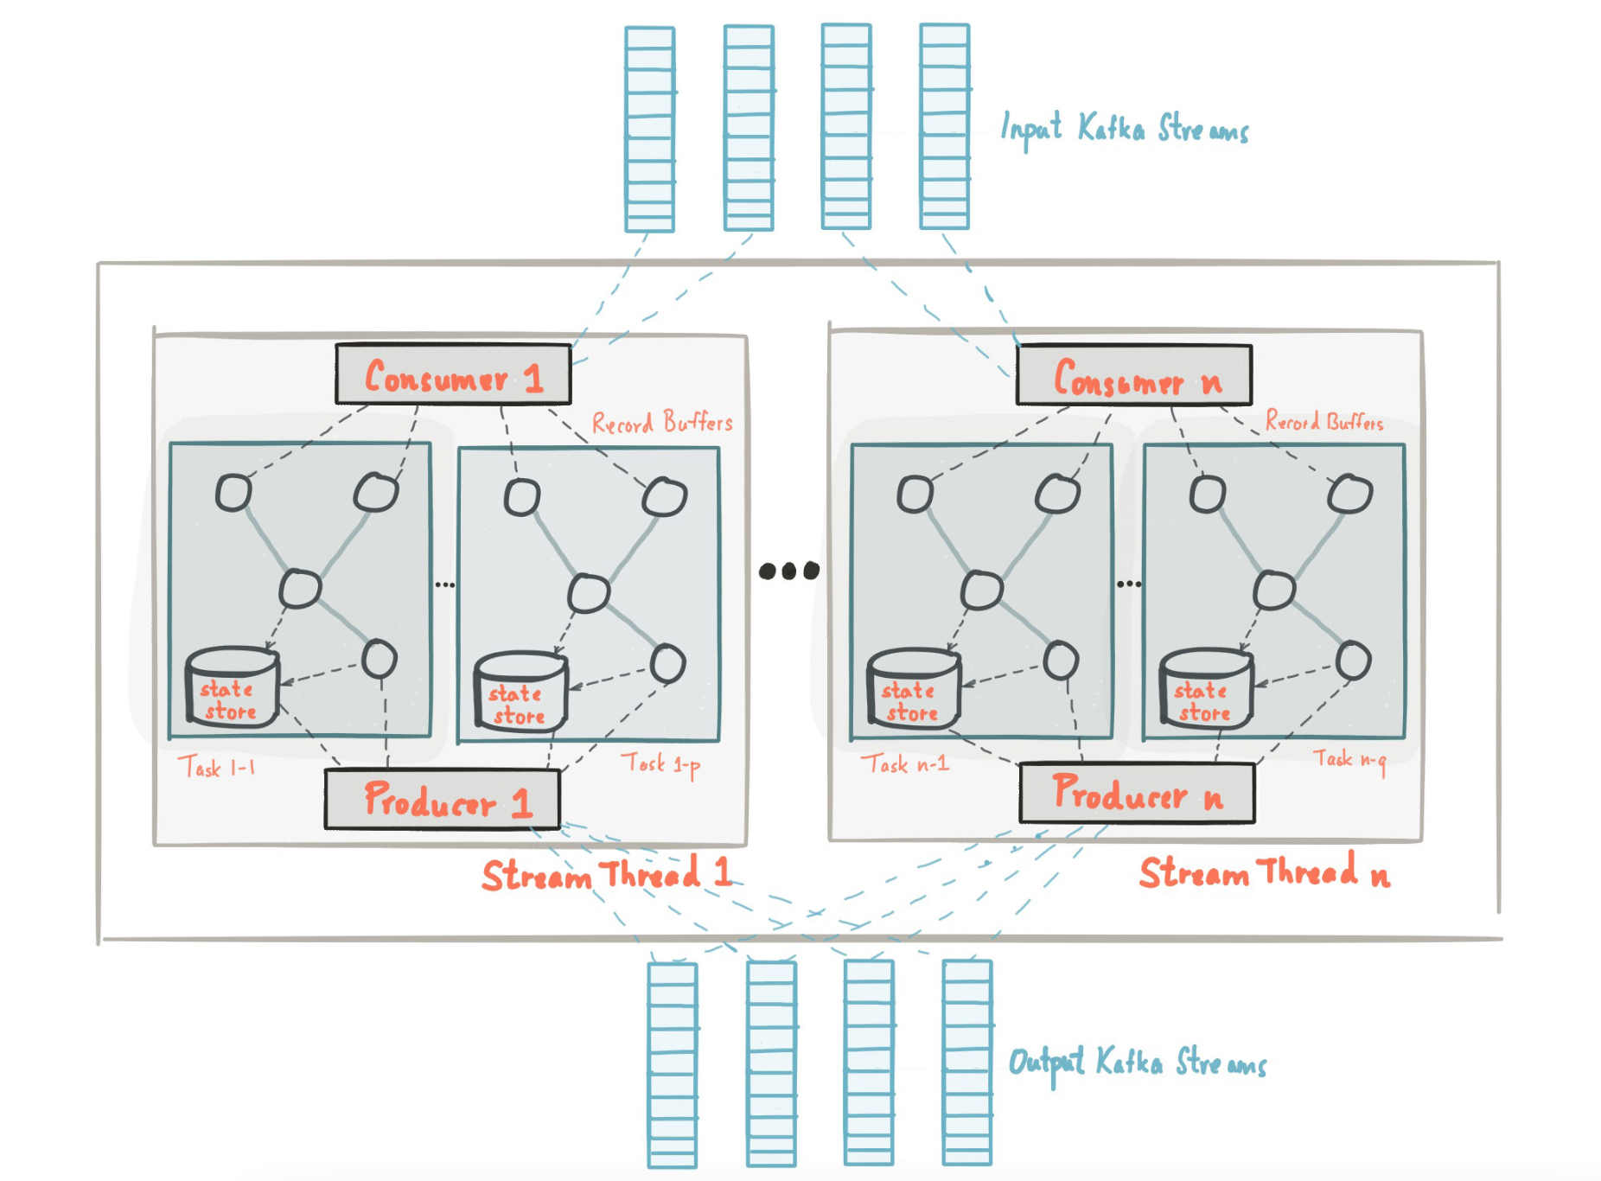
Streaming

Slide 29
Streaming
If we would like to switch from req/resp model to world of streams
Immediatelly propagate event as they occur in our system
Fully async communication
Build materialized views on top of topics

Slide 31
Streaming
Kafka has build-in API for that!
Processor, KStream, Ktables, GlobalKTable are your friends
You can build your application based on that API
These applications are run outside of the Broker
Dedicated DSL

Slide 32
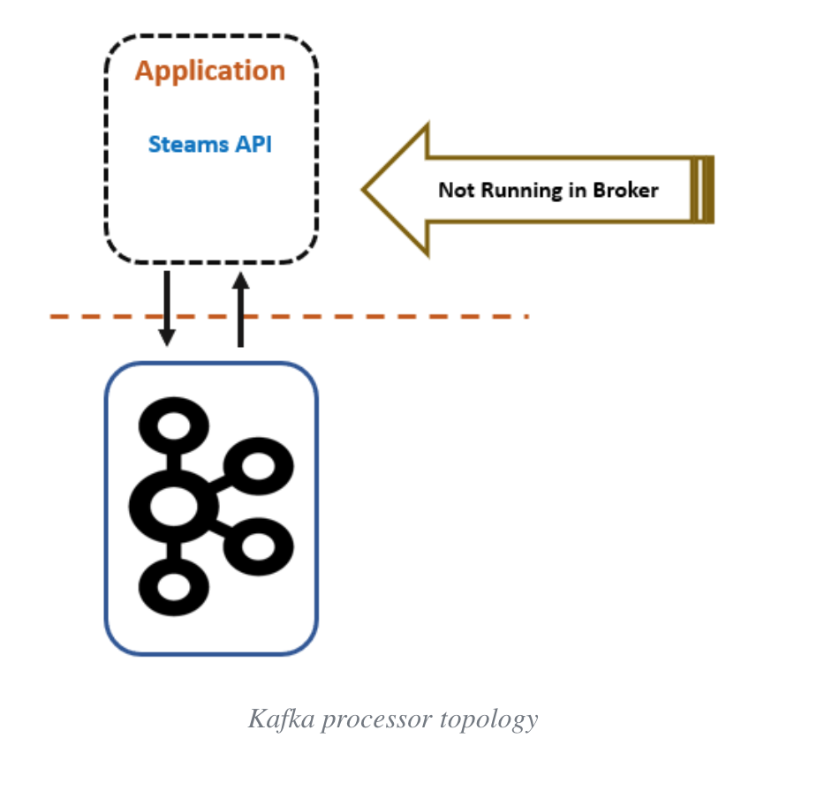
Source: https://dzone.com/articles/real-time-stream-processing-with-apache-kafkapart-1

Slide 33
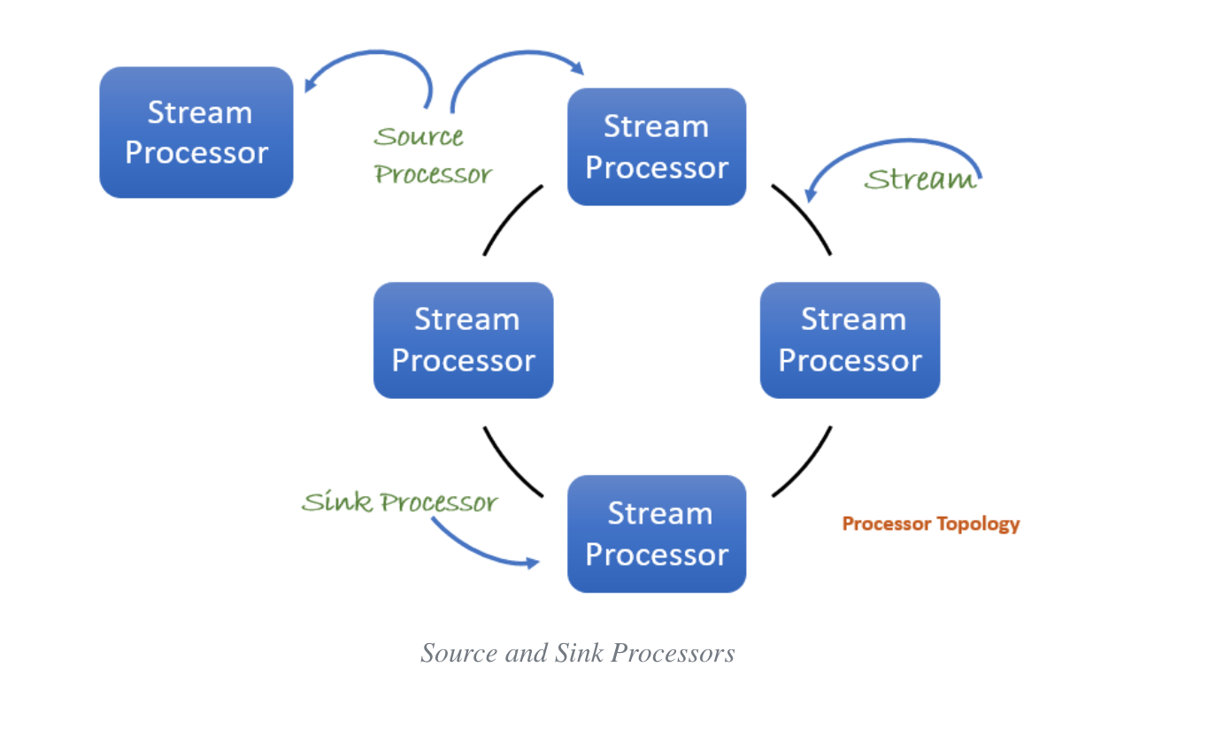
Source: https://dzone.com/articles/real-time-stream-processing-with-apache-kafkapart-1

Slide 34
Streaming - examples
Aggregations – numer of visits from particular country
Joins – visitors and their preferences
Filtering
Windowing – how many events per min/hour/day
KTables
Views

Slide 35
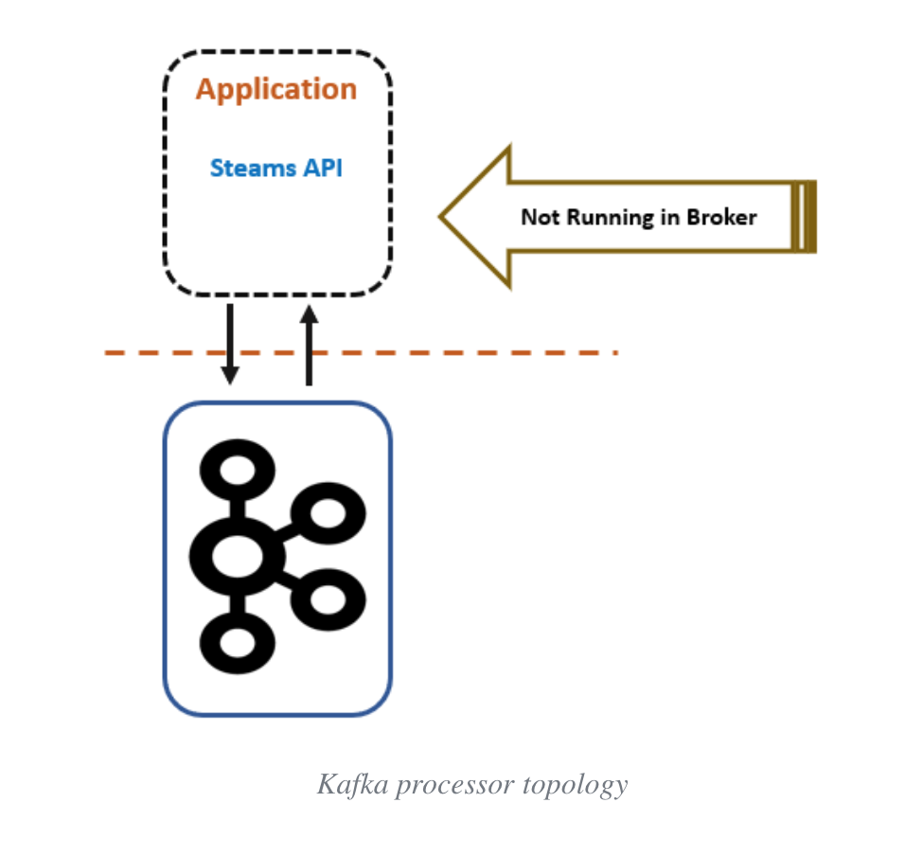
Real-Time processing

Slide 36
Metrics / Log aggregation
Ingest high load of data to your system
Real-time is not that important
Throughtput is most important here
It should survive extream numer of incomming messages
Processing might take some time, but message/event/logs/metric must be received
Examples: Datadog / Elastic / Librato / Splunk etc.

Slide 37

Event Sourcing + CQRS

Slide 38
Event Sourcing
Problem:
A service typically needs to update the database and send messages/events.
A service must atomically update the database and send messages in order to avoid data inconsistencies and bugs.

Slide 39
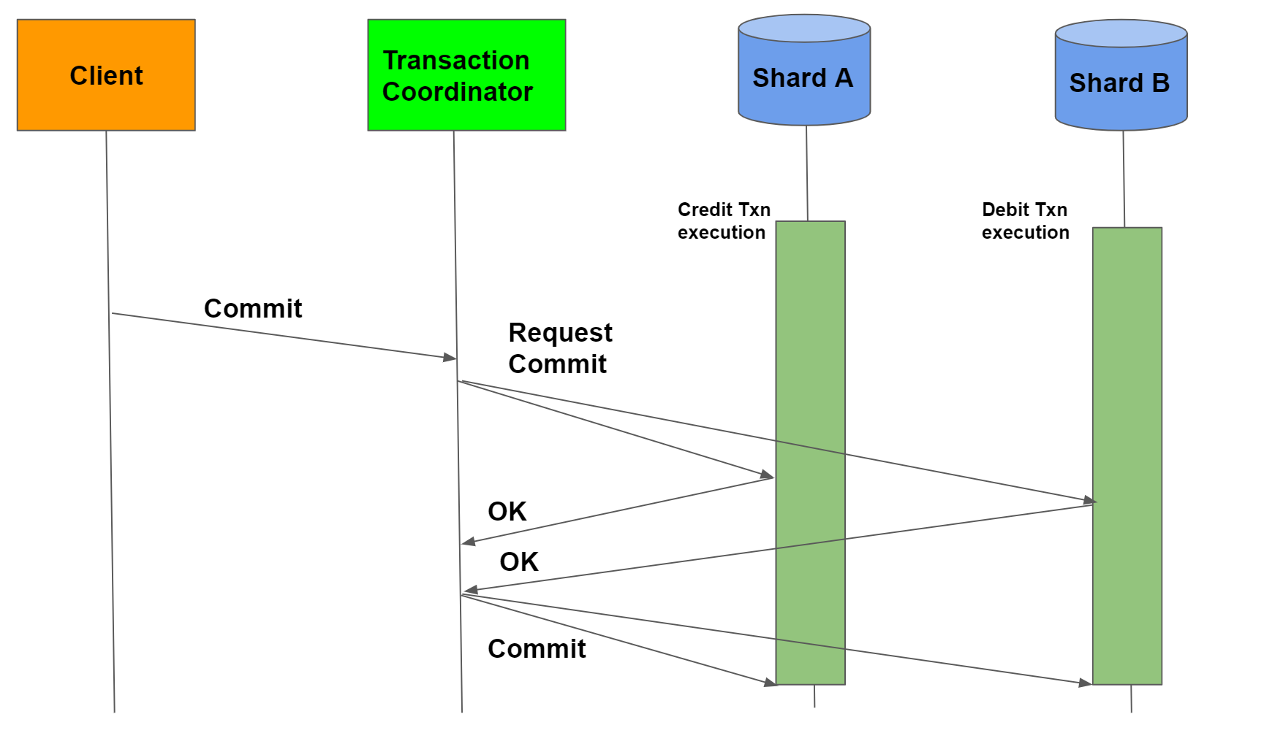
Event Sourcing
Solution:
2PC – Two Phase Commit

Slide 40
Event Sourcing
Problem:
Make update the database and publish messages/events to another system
It works in context of 2 DBs, but not when we have 1DB and 1 messaging system(of course if queue doesn’t supports 2PC)
If the database transaction commits messages must be sent. Conversely, if the database rolls back, the messages must not be sent

Slide 41
Event Sourcing
Solution to this problem is to use event sourcing.
Event sourcing persists the state of a business entity such an Order or a Customer as a sequence of state-changing events
Whenever the state of a business entity changes, a new event is appended to the list of events.
Since saving an event is a single operation, it is inherently atomic.
The application reconstructs an entity’s current state by replaying the events.

Slide 42
Event Sourcing
Applications persist events in an event store, which is a database of events.
The store has an API for adding and retrieving an entity’s events.
The event store also behaves like a message broker.
It provides an API that enables services to subscribe to events.
When a service saves an event in the event store, it is delivered to all interested subscribers.

Slide 43
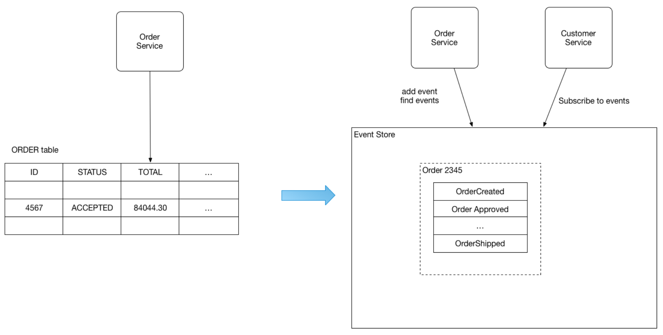
Event Sourcing

Slide 44
Event Sourcing – another problem
How to query Event store to get current state of Order?
Should we query for all of the events every time?

Slide 45
CQRS

Slide 46
CQRS
CQRS = Command Query Responsibility Segregation
Problem
How to implement a query that retrieves data from multiple services in a microservice architecture?

Slide 47
CQRS
Solution:
Define a view database, which is a read-only replica that is designed to support that query.
The application keeps the replica up to data by subscribing to Domain events published by the service that own the data.

Slide 48
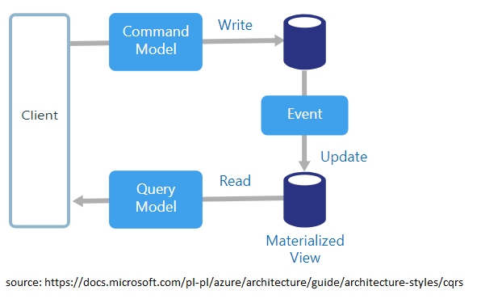
CQRS

Slide 49
CQRS
This pattern has the following benefits:
Supports multiple denormalized views that are scalable and performant
Improved separation of concerns = simpler command and query models
Necessary in an event sourced architecture

Slide 50
CQRS
This pattern has the following drawbacks:
Increased complexity
Potential code duplication
Replication lag/eventually consistent views

Slide 51
Event Sourcing – with Kafka
To implement CQRS with Kafka, you write directly to a topic,
This is faster than writing to a database, which has indexes that must be updated.
The events are then pushed from Kafka into a view on the read side, from where they can be queried.
Chronological reductions are performed before the data is inserted into the view.

Slide 52

Change Data Capture

Slide 53
Change Data Capture
change data capture (CDC) is a set of software design patterns used to determine and track the data that has changed so that action can be taken using the changed data.

Slide 54
Log-based Change Data Capture
Based on WAL, Redo logs, Binlog
All data changes are captured
No polling or overhead
Transparent – no need to touch any of old/legacy applications
Event with changes is sent to subscribers
Reactive approach

Slide 55
SQL
CREATE TABLE users (
id SERIAL PRIMARY KEY,
firstname TEXT NOT NULL,
lastname TEXT NOT NULL,
created_at TIMESTAMP DEFAULT NOW()
);

Slide 56
Following INSERT
INSERT INTO users(firstname, lastname) VALUES('Johny', 'Rambo');
Produces following EVENT
{
"change": [
{
"kind": "insert",
"schema": "public",
"table": ”users",
"columnnames": [”id”, ”firstname", ”lastname", "created_at"],
"columntypes": [
"integer",
”text",
”text",
"timestamp without time zone"
],
"columnvalues": [1, ”Johny", ”Rambo", "2020-09-15 11:58:28.988414"]
}
]
}

Slide 57
Following UPDATE
UPDATE users SET lastname = 'Kowalski' WHERE id = 1;
Produces following EVENT
{
"change": [
{
"kind": "update",
"schema": "public",
"table": "users",
"columnnames": ["id", "firstname", "lastname", "created_at"],
"columntypes": ["integer", "text", "text", "timestamp without time zone"],
"columnvalues": [1, "Johny", "Kowalski", "2020-09-15 11:58:28.988414"],
"oldkeys": {
"keynames": ["id"],
"keytypes": ["integer"],
"keyvalues": [1]
}
}
]
}

Slide 58
Following DELETE
DELETE FROM users WHERE id = '1';
Produces following EVENT
{
"change": [
{
"kind": "delete",
"schema": "public",
"table": "users",
"oldkeys": {
"keynames": ["id"],
"keytypes": ["integer"],
"keyvalues": [1]
}
}
]
}

Slide 59

Streaming

Slide 60

Streaming
Legacy App
DB

Slide 61

Streaming
Legacy App
DB
ElasticSearch
CDC

Slide 62
CDC - Microservices Communication

Slide 63
Data Synchronization
Analytics DB
Insert
Create New Account
Users Service
Insert
DB
Insert
ElasticSearch
BAD DESIGN

Slide 64
Data Synchronization
Create New Account
Users Service
Insert
DB
Propagate data between different
services without coupling
Inserted User
Inserted User
CDC
Inserted User
Inserted User
Audit DB
Kafka Connect Sink Connector
Analytics Service
Analytics DB

Slide 65

Replication

Slide 66
Replication and Geo-replication – why?
Geo-replication
Disaster recovery
Feeding edge clusters into a central, aggregate cluster
Physical isolation of clusters (such as production vs. testing)
Cloud migration or hybrid cloud deployments
Legal and compliance requirements

Slide 67
Mirror Maker
Replication and geo-replication is done with MirrorMaker(2)
MirrorMaker 2 (MM2) is designed to make it easier to mirror or replicate topics from one Kafka cluster to another.
It uses the Kafka Connect framework to simplify configuration and scaling.
Dynamically detects changes to topics and ensures source and target topic properties are synchronized, including offsets and partitions

Slide 68
Replication types
Active/Active high availability deployments: A->B, B->A
Active/Passive or Active/Standby high availability deployments: A->B
Aggregation (e.g., from many clusters to one): A->K, B->K, C->K
Fan-out (e.g., from one to many clusters): K->A, K->B, K->C
Forwarding: A->B, B->C, C->D

Slide 69
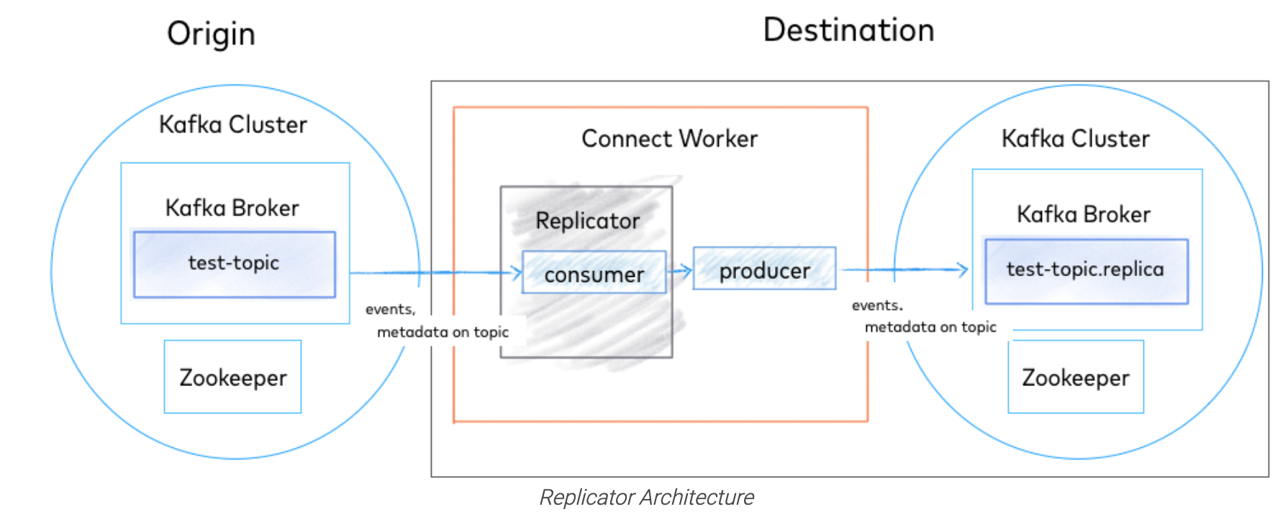
Replication and Geo-replication
Source: https://docs.confluent.io/platform/current/multi-dc-deployments/replicator/index.html

Slide 70

Exercise

Slide 71

Alternatives to Apache Kafka

Slide 72
Alternatives to Apache Kafka - As Queue
RabbitMQ
AtiveMQ
NATS
Redis
Amazon SQS / Azure Service Bus / GCE Pub/Sub

Slide 73
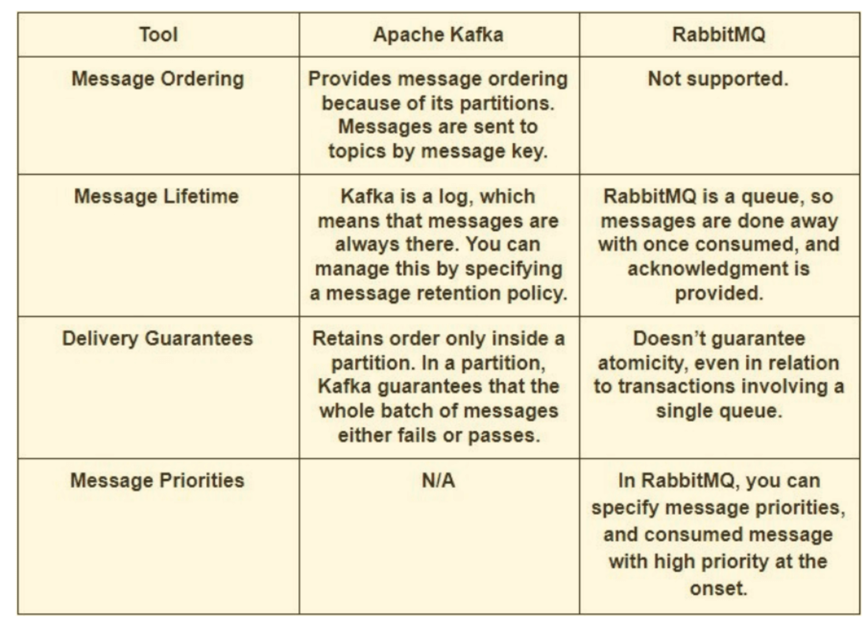
RabbitMQ vs Kafka
Source: https://www.upsolver.com/blog/kafka-versus-rabbitmq-architecture-performance-use-case

Slide 74
RabbitMQ
Scenarios that RabbitMQ can be used for:
Applications that need to support legacy protocols, such as STOMP, MQTT, AMQP, 0-9-1.
Granular control over consistency/set of guarantees on a per-message basis
Complex routing to consumers – like priorities
Applications that need a variety of publish/subscribe, point-to-point request/reply messaging capabilities.

Slide 75
AtiveMQ
JMS API implements a fundamental semantic difference between a queue (peer-to-peer) and topic(publish-subscribe) destinations.
ActiveMQ provides optional durability - Storage is non required
All messages are coming in one flow
Messages are round-robin distributed between a unlimited number of consumers
Storage is non required
Besides native OpenWire it also supports AMQP, STOMP, MQTT, XMPP.

Slide 76
NATS
NATS is lightweight pub-sub messaging platform
NATS implements what is commonly referred to as at-most-once delivery
if a subscriber drops out, it will not receive messages
NATS platform is a simple pub-sub transport system that offers only TCP-grade reliability
Usually it’s faster
NATS cluster is much simpler to operate

Slide 77
Redis pub-sub
Redis supports push-based delivery of messages
every message pushed to Redis will be delivered automatically to all the subscribers
Redis does not store messages instead
Redis is used usually If you want a fire-and-forget kind of system

Slide 78
Amazon SQS / Azure Service Bus / GCE Pub/Sub
All of them in SaaS model
No hosting available outside of AWS/Google/Azure
Contains messages limits
Shines in ecosystem

Slide 79
Alternatives to Apache Kafka - As Messaging Platform
Apache Spark
Apache Storm
Apache Flume

Slide 80
Apache Spark
Usually it’s Kafka Streams vs Apache Spark Streaming
We cannot use Apache Spark as messaging system

Slide 81
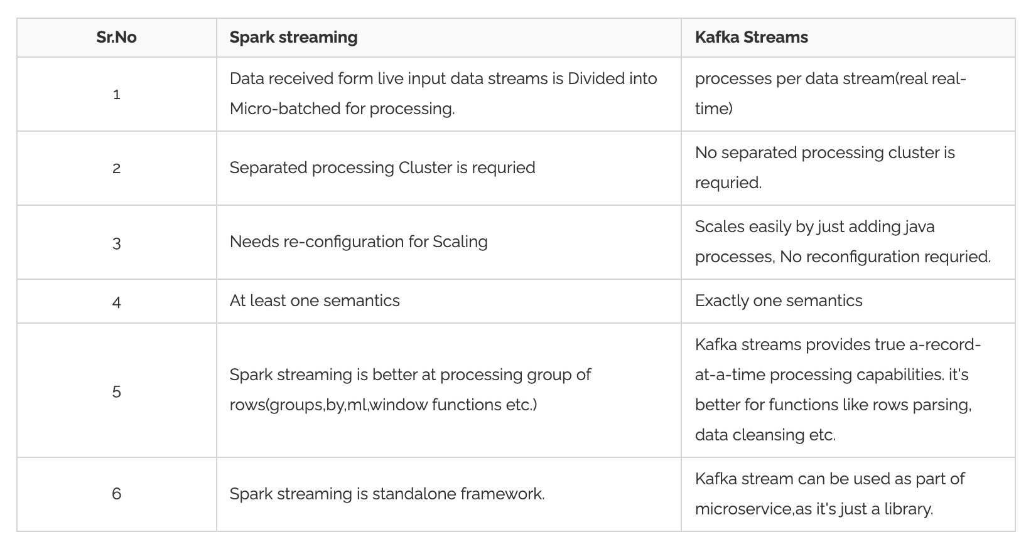
Source: https://www.knowledgehut.com/blog/big-data/kafka-vs-spark

Slide 82
Apache Flume
Again it’s Kafka Streams vs Apache Flume
We cannot use Apache Flume as messaging system
It is basically working as a push model
It is specially designed for Hadoop.
Common use-case: collect log data from distributed web servers.

Slide 83
Apache Storm
Storm works on a Real-time messaging
Kafka can store its data on local filesystem while Apache Storm is just a data processing framework.
Kafka is a real-time streaming unit while Storm works on the stream pulled from Kafka.

Slide 84
Exercise

Slide 85
Kafka Design

Slide 86
Design
Motivation
Main concepts
Persistence
Performance
The Producer
The Consumer
Message Delivery Semantics
Replication

Slide 87
Motivation

Slide 88
Motivation
Kafka was developed around 2010 at LinkedIn by a team that included Jay Kreps, Jun Rao, and Neha Narkhede
Problem which solves was low-latency ingestion of large amounts of event data from the LinkedIn
The key was the "real-time" processing.
At the time, there weren't any solutions for this type of ingress for real-time applications.
Real-time systems such as the traditional messaging queues (think ActiveMQ, RabbitMQ, etc.) they are overkill for the use case LinkedIn had in mind

Slide 89
Motivation
LinkedIn) wants to build fancy machine-learning algorithms, but without the data, the algorithms are useless
Getting the data from source systems and reliably moving it around was very difficult
Back in 2011, Kafka was ingesting more than 1 billion events a day
Recently, LinkedIn has reported ingestion rates of 1 trillion messages a day

Slide 90
Main concepts

Slide 91
Records
Records = message = event
Each record consists of a key, a value, and a timestamp.
Categorized into Topics
Message = byte array
Serializer is not necessary

Slide 92
Topics
A topic is a category to which records are published.
Producers write data to topics and consumers read from them
Topics in Kafka are always multi-subscriber
Topics are partitioned
Topics are persistent – records are stored on the disk

Slide 93
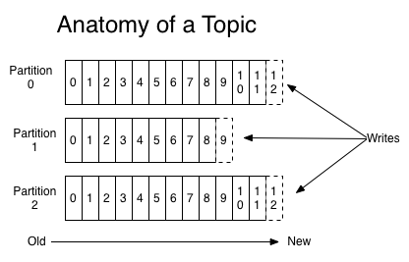
Source: https://kafka.apache.org/intro

Slide 94
Partitions
Each topic has one or more partitions
Order is preserved within single partition
Partitions are replicated across cluster
Records are added to the very end of each partitions

Slide 95
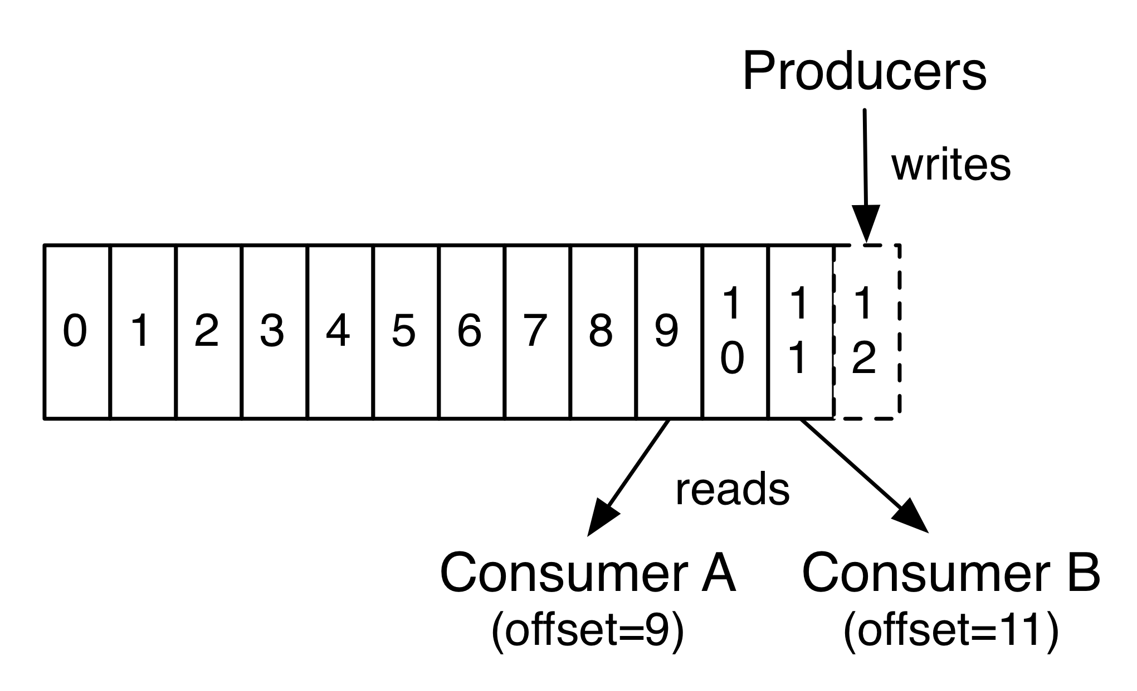
Partition Offset
Each partitioned message has a unique sequence ID called an offset.
Offset is unique per partition only
Source: https://kafka.apache.org/intro

Slide 96
Replicas
Replica is a backup of a partition
Replication factor tells the cluster how many of identical replicas should be created on the cluster
Replicas are never used to read or write data.
They are used to prevent data loss.
There can be one or many replicas of a partition
One leader and many followers
In-Sync Replica is a replica that has enough records to be considered in partition leader election

Slide 97
Brokers
Kafka Broker is a Kafka server that manages records
Receives messages
Assigns offsets
Commits messages to storage on disk
Each broker may have zero or more partitions per topic.

Slide 98
Cluster
When Kafka has more than one broker, it is called a Kafka cluster.
A Kafka cluster can be expanded without downtime.

Slide 99
Zookeeper
It backups the date critical metadata of Kafka Cluster
Responsible for ellection
Stores ACLs
Stores list of available Kafka brokers

Slide 100
Persistence

Slide 101
Topic partitions and log segments
The data in a topic partition is split into log segments.
For each log segment, there is a file on disk.
One of the segments is the active segment into which messages are currently written.
Once the size or time limit of the active segment is reached, the corresponding file is closed and a new one is opened.
By splitting the data of a topic partition into segments, Kafka can purge and compact messages from the non-active segments.

Slide 102
Topic partitions and log segments
When the data is written to a log segment, by default it is not flushed to disk immediately.
Kafka relies on the underlying operating system to lazily flush the data to disk, which improves performance.
Although this might appear to increase the risk of data loss, in most cases, each topic partition will be configured to have more than 1 replica.
So, the data will exist on more than one broker.

Slide 103
Topic partitions and log segments
Kafka has server and per-topic configuration parameters that allow the frequency of flushing of segment data to disk
In general, you should not override the default of allowing the operating system to decide when to flush the segment data to disk
You should rely on replication for the durability of your data.
Kafka deeply leverages the Linux page cache and zero-copy mechanism to avoid copying data into user space.

Slide 104
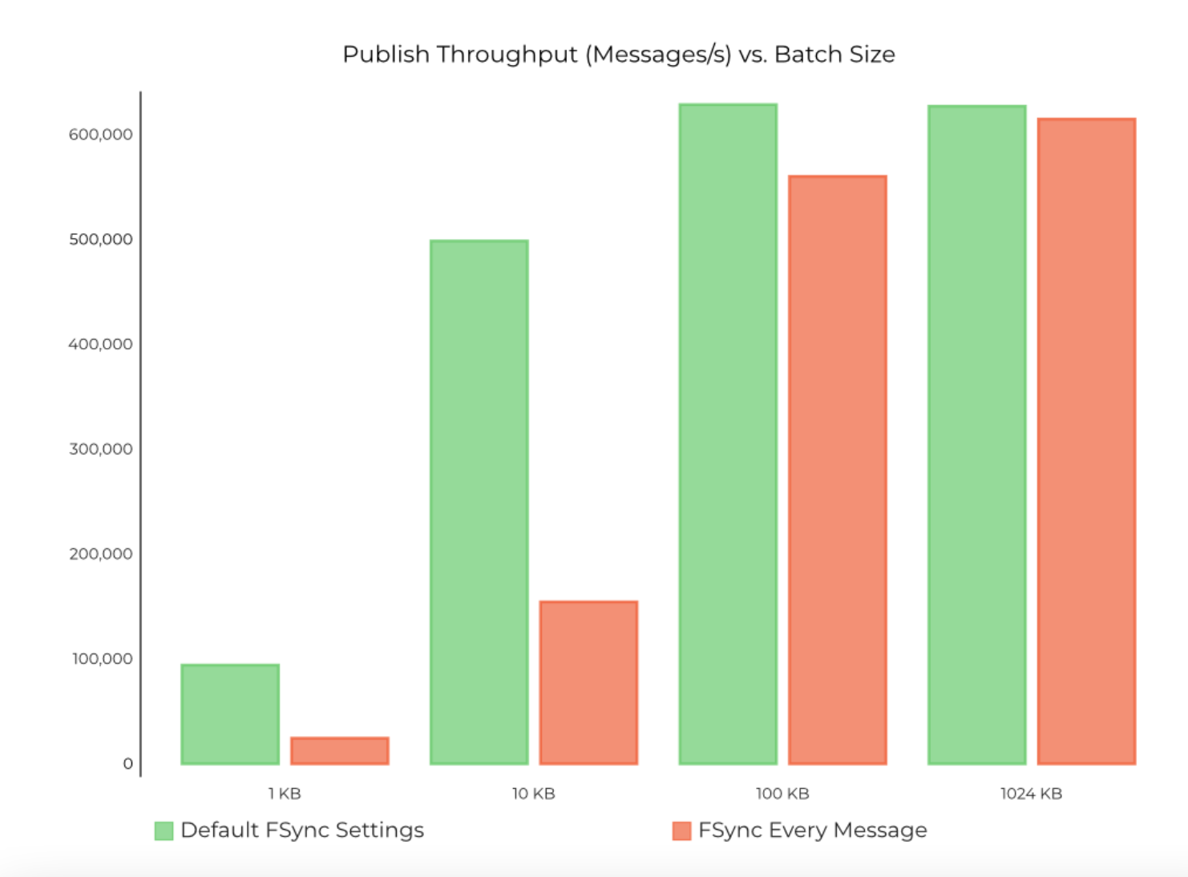
Persistence
Source: https://www.confluent.io/blog/kafka-fastest-messaging-system/

Slide 105
Performance

Slide 106
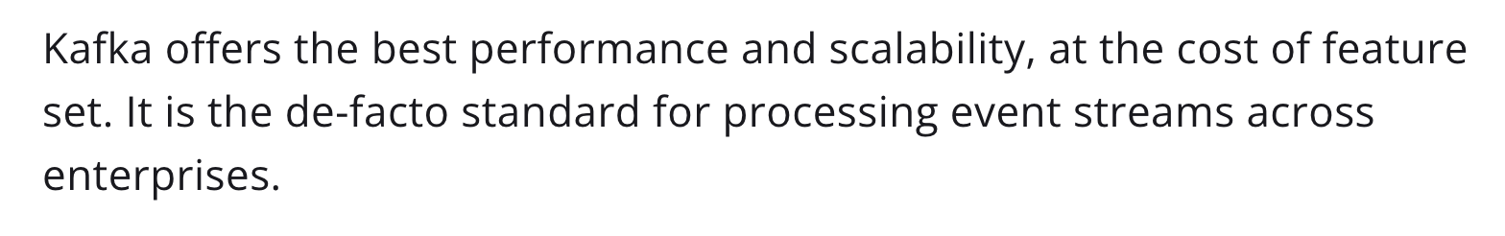
Performance
Great articles which covers the topic:
https://softwaremill.com/mqperf/
https://www.confluent.io/blog/kafka-fastest-messaging-system/
To sum things up:

Slide 107
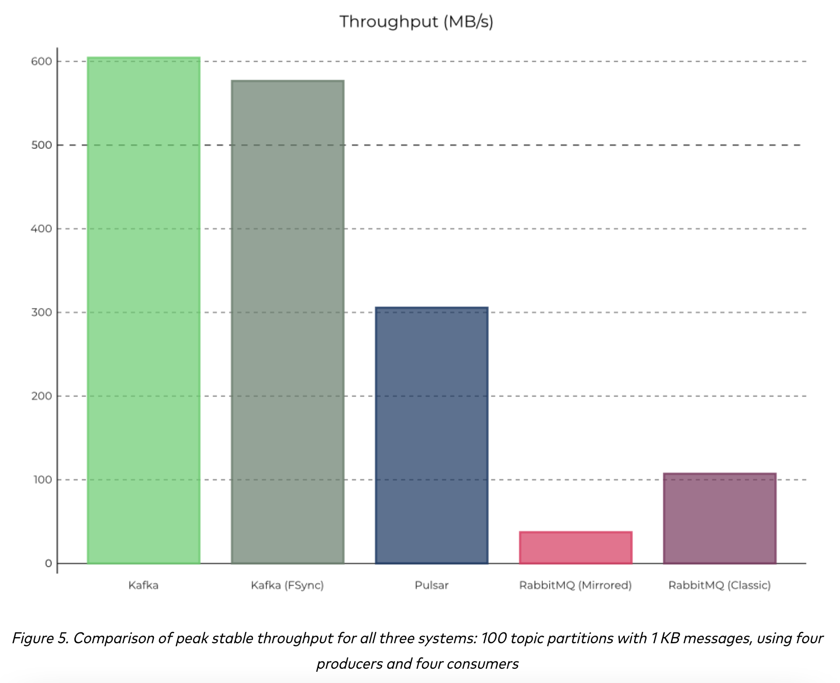
Performance
Source: https://www.confluent.io/blog/kafka-fastest-messaging-system/

Slide 108
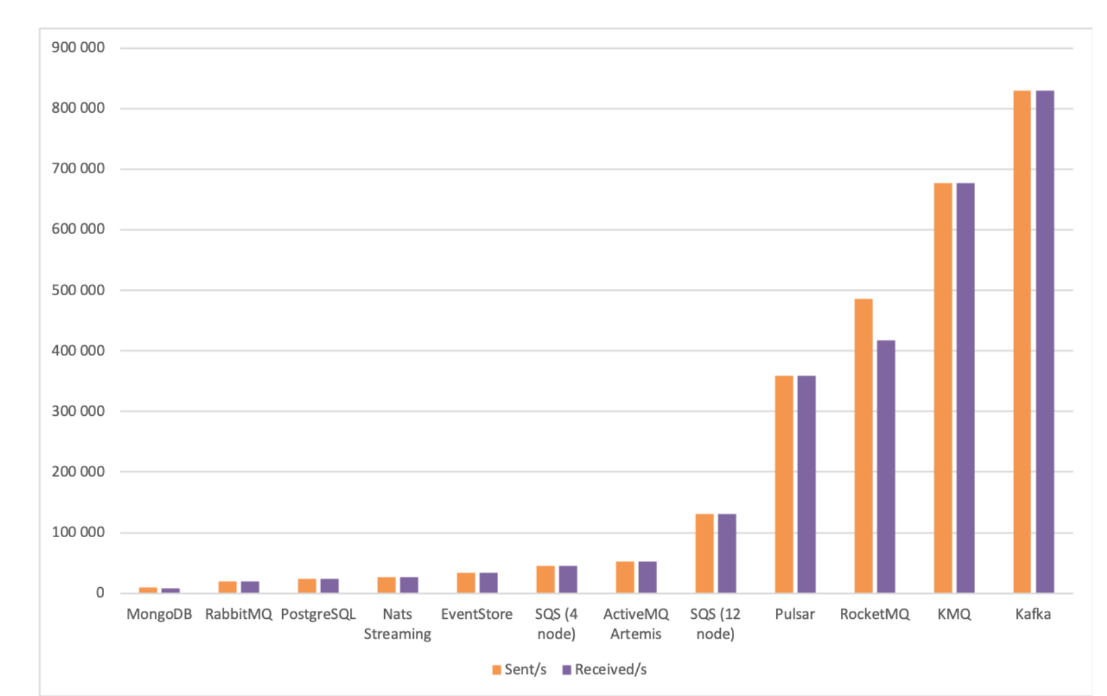
Performance
Source: https://softwaremill.com/mqperf/

Slide 109
Performance
Kafka has almost always best throughput
Latency is not always that good
Scales great
Wins most of the benchmarks

Slide 110
Message Delivery Semantics

Slide 111
Message Delivery Semantics
There are multiple possible message delivery guarantees that could be provided:
At most once —Messages may be lost but are never redelivered.
At least once—Messages are never lost but may be redelivered.
Exactly once—this is what people actually want, each message is delivered once and only once.
It's worth noting that this breaks down into two problems: the durability guarantees for publishing a message and the guarantees when consuming a message.

Slide 112
At least once

Slide 113
Exactly once

Slide 114

Kafka Features

Slide 115
Multi Tenancy
You can deploy Kafka as a multi-tenant solution.
Multi-tenancy is enabled by configuring which topics can produce or consume data
Support for quotas - administrators can define quotas to control the broker resources that are used by clients.

Slide 116
Geo Replication
Kafka MirrorMaker provides geo-replication support.
messages are replicated across multiple datacenters or cloud regions
active/passive scenarios for backup and recovery;
active/active scenarios to place data closer to your users

Slide 117
Guarantees
At a high-level Kafka gives the following guarantees:
Messages sent by a producer to a particular topic partition will be appended in the order they are sent
Consumer sees records in the order they are stored in the log.
Topic with replication factor N, we will tolerate up to N-1 server failures.

Slide 118
Retention
The message remains in the topic for:
Configurable period of time or
Configurable size is reached
Retention is set per Topic

Slide 119
Log Compaction
Retains at least the last known value for each record key for a single topic partition
Compacted logs are useful for restoring state after a crash or system failure.
Used also for deletion of single message

Slide 120
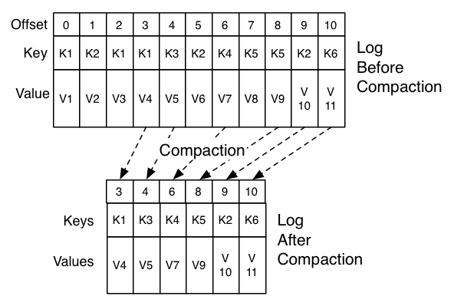
Log Compaction
Source: https://kafka.apache.org/intro

Slide 121
Kafka API

Slide 122
Kafka API
Producer API
Consumer API
Kafka Connect
Kafka Streams
Admin API

Slide 123
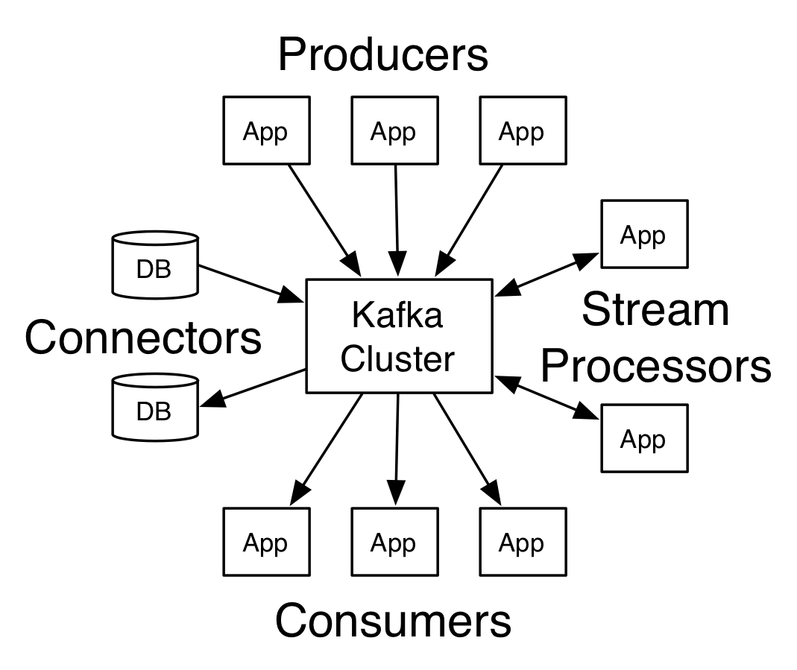
Kafka API
Source: https://kafka.apache.org/intro

Slide 124
Producer API
The Producer API allows an application to publish a stream of records to one or more Kafka topics.

Slide 125
Consumer API
The Consumer API allows an application to subscribe to one or more topics and process the stream of records produced to them.

Slide 126
Streams API
The Streams API allows an application to act as a stream processor, consuming an input stream from one or more topics and producing an output stream to one or more output topics, effectively transforming the input streams to output streams.

Slide 127
Connector API
The Connector API allows building and running reusable producers or consumers that connect Kafka topics to existing applications or data systems. For example, a connector to a relational database might capture every change to a table.

Slide 128
Configuration

Slide 129
Configuration
New Producer
Broker
Consumer and Producer Configuration

Slide 130
New Producer

Slide 131
Broker

Slide 132
Consumer and Producer Configuration

Slide 133

Implementation details

Slide 134
Implementation details
API Design
Network Layer
Messages
Message format
Log
Distribution

Slide 135
API Design

Slide 136
Network Layer

Slide 137
Messages

Slide 138
Message format

Slide 139
Log

Slide 140
Distribution

Slide 141
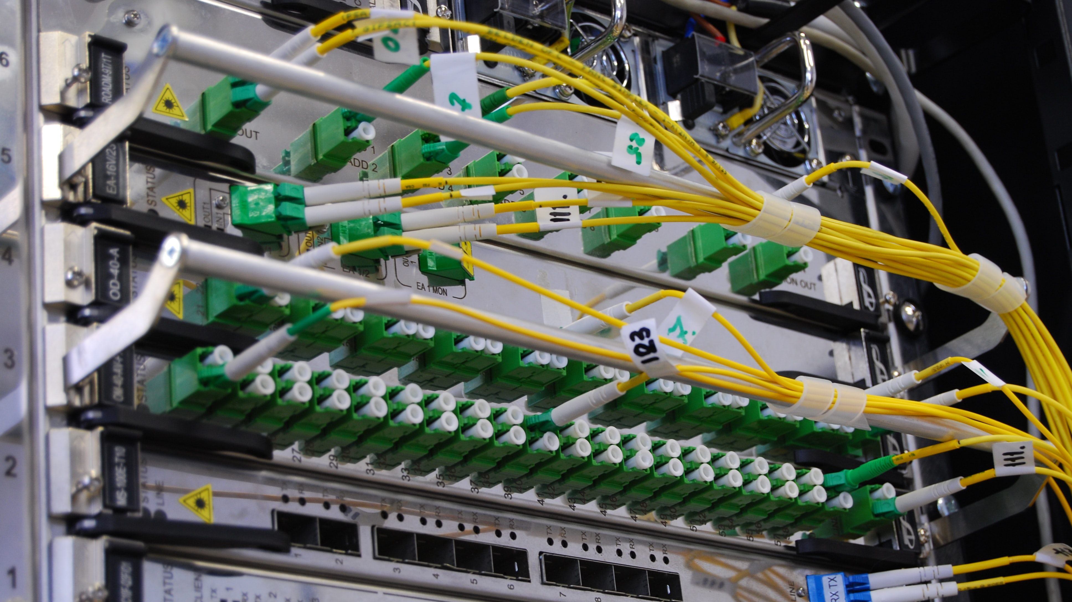
Basic Kafka Operations

Slide 142
Basic Kafka Operations
Adding and removing topics
Modifying topics
Graceful shutdown
Balancing leadership
Checking consumer position
Mirroring data between clusters
Expanding your cluster
Decommissioning brokers
Increasing replication factor

Slide 143
Adding and removing topics

Slide 144
Modifying topics

Slide 145
Graceful shutdown

Slide 146
Balancing leadership

Slide 147
Checking consumer position

Slide 148
Mirroring data between clusters

Slide 149
Expanding your cluster

Slide 150
Decommissioning brokers

Slide 151
Increasing replication factor

Slide 152

Other

Slide 153
Other
Datacenters
Important Server Configs
Important Client Configs
Production Server Configs
Monitoring
ZooKeeper

Slide 154
Extras
Kafka + Kubernetes
Kubernetes Operator
Kubernetes Storage
Strimzi
CDC with Debezium
Serializers
Schema Registry
Security

Slide 155

Thanks!

